Slide 1
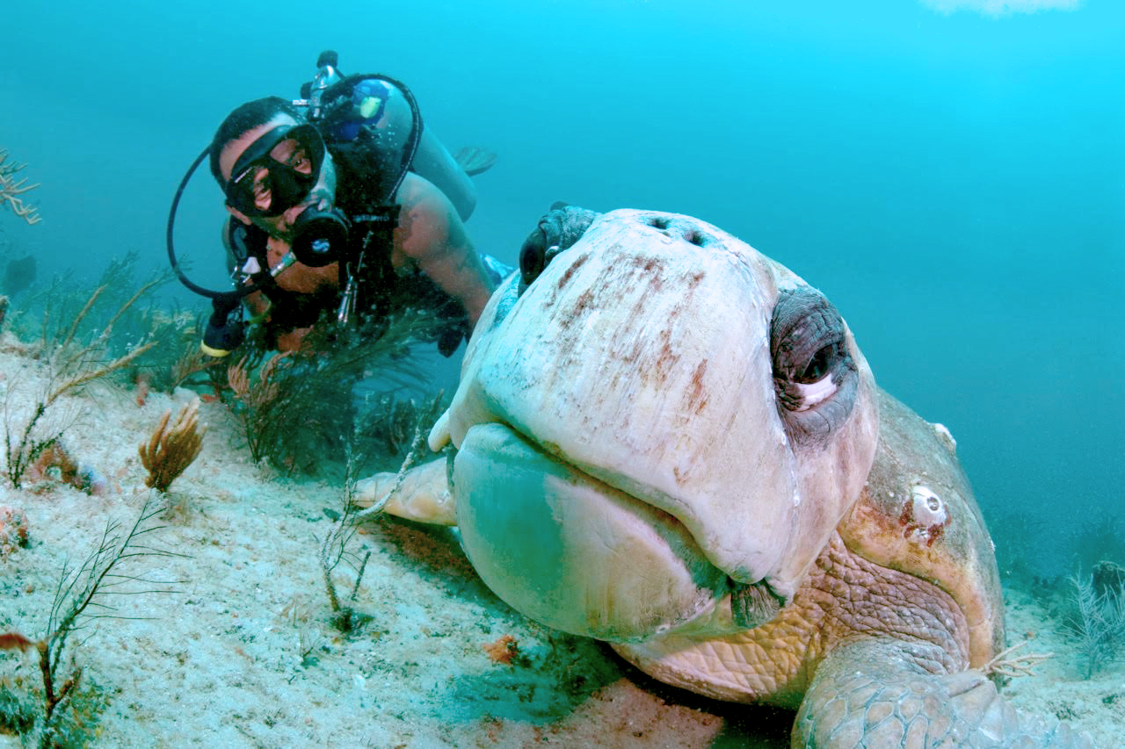
WATCH Your scuba diving
by: Security Application Via Engineering AS
Honorable mentions:
Chrisander Bronstad
Jan Ali
Joe Liu
Zakiya Yusefi

Slide 2
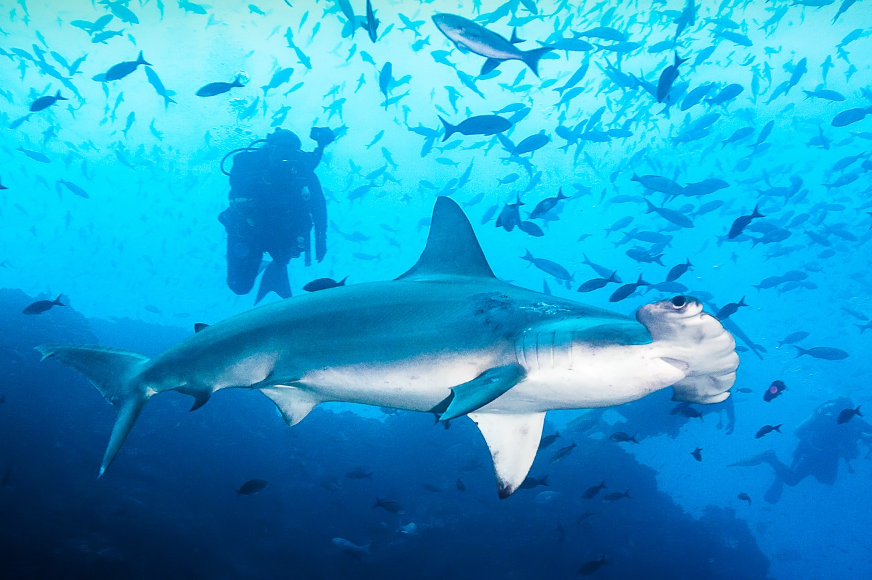

Slide 3
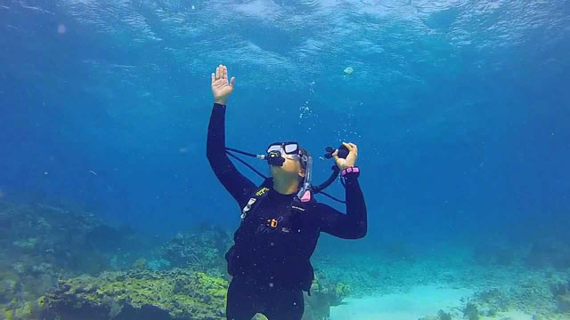

Slide 4
We need to find a safe, reliable, user-friendly oxygen information/warning system which provides for the general scuba diver a more secured and independent diving experience.

Slide 5
Business opportunity:
Provide scuba diving experience for amateur individuals that can be more independent from the expertise required to have a safe scuba diving tour.
The opportunity doesn’t need to just be limited to amateur scuba divers, but also the more experienced one in the manner of a more worry-free diving. To perform a highly efficient diving activity. The diver should not be required to constantly check the regulator which reduces stress and make them focus more on the task itself.
Larger oxygen tanks/capacity can be applied due to mind-free low-level oxygen risk warning.

Slide 6
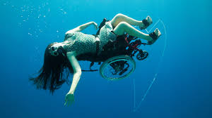

Slide 7
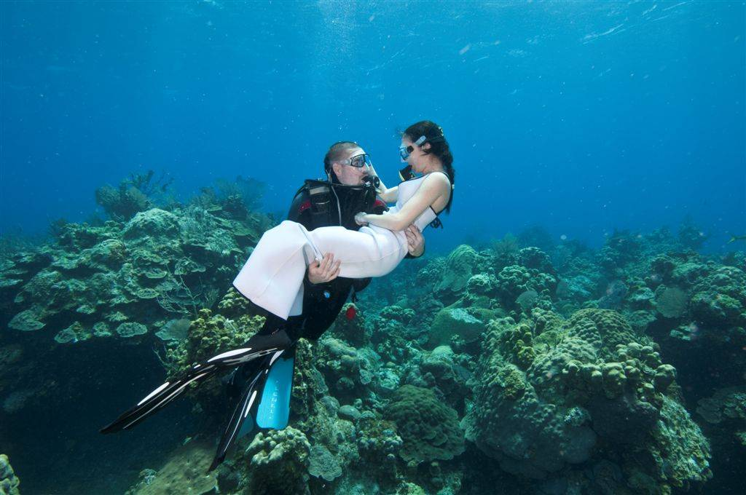

Slide 8
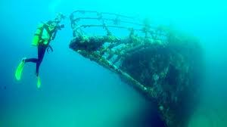

Slide 9
Statement of the goals and objectives of the system:
to ensure a reliable and safe warning system for novel divers. To enhance their diving experience by reducing stress
CONOPS

Slide 10
Boundaries of the system and its external interfaces.
Deep sea level
Based on existing products
CONOPS

Slide 11
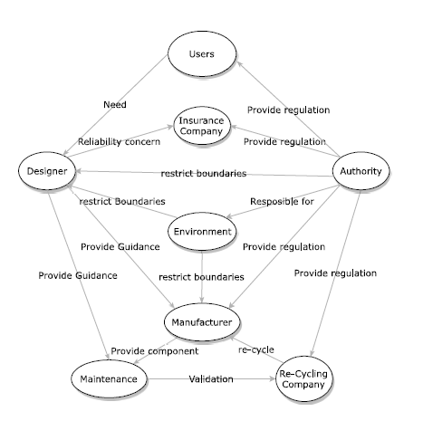
Stakeholders (and interactions between them).
CONOPS

Slide 12
Policies and/or constraints that affect the system or that influence it.
Encouragement of Scuba Diving Business
Product regulation
Environment regulation
CONOPS

Slide 13
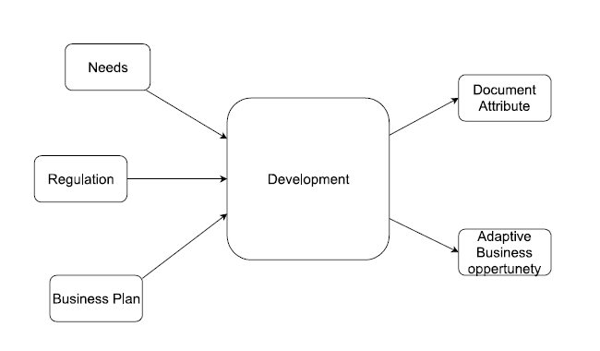
Conceptual view of the system
To make sure the safety of the user
To provide scuba diving experience for a wide range of users
CONOPS

Slide 14
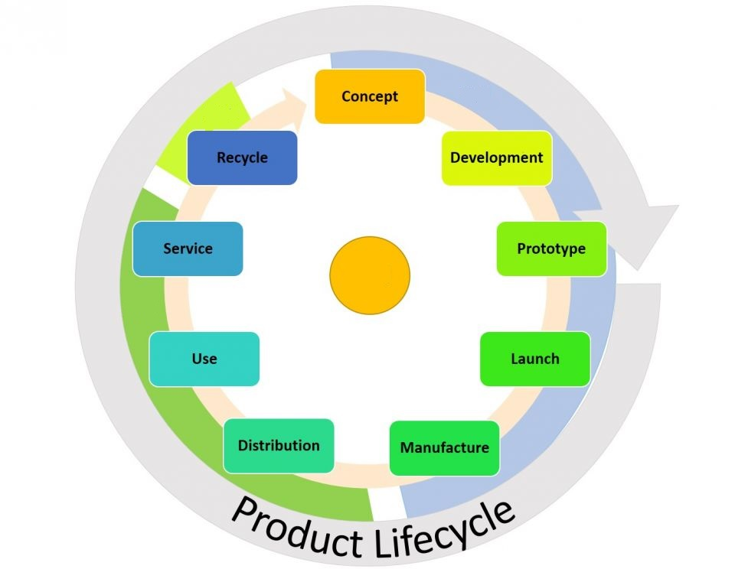

Slide 15
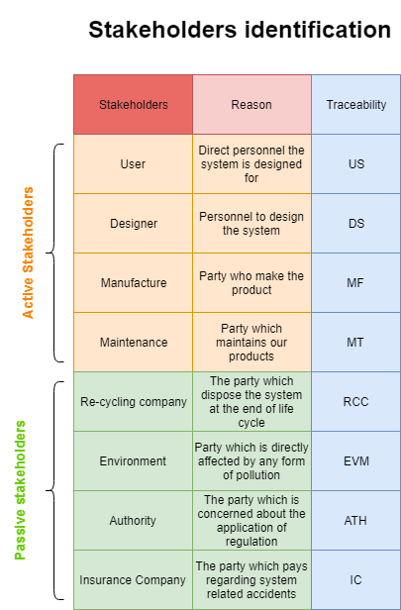
Stakeholders

Slide 16
Factors | need | code | concerns
User | The system should be user-friendly. | SHR1 | The system might be hard to use
 | The system should be reliable. | SHR2 | The system may malfunction during usage
 | The system should be safe. | SHR3 | The system may be toxic.
 | The system should be cheap. | SHR4 | The product might be over the users’ budget.
Designer | The system should be practical. | SHR5 | The development of the system might be time consuming.
 | The system should be profitable. | SHR6 | The system is not attractive in the users’ point of view.

Slide 17
Manufacture | The system should be easy to manufacture. | SHR7 | The system might take too long time to test/validate
Authority | The system should fulfil the regulations. | SHR8 | NA
Environment | The system should be pollution free. | SHR9 | The system might damage the environment.
Insurance Company | The system should be well documented to make it easy to asses risk-evaluation | SHR10 | NA
Maintenance | The system should assemble in a maintenance friendly manner. | SHR11 | The system might be hard to diagnose when malfunction
 | The system should durable regarding wear and tear. | SHR12 | The system might have a high life cycle cost.
Re-cycling company | The system should be reusable. | SHR13 | NA

Slide 18
Stakeholder requirements
Stakeholders | Requirements | SH code
User | The system should be user-friendly. | SHR1
 | The system should be reliable. | SHR2
 | The system should be safe. | SHR3
 | The system should be cheap. | SHR4
Designer | The system should be practical. | SHR5
 | The system should be profitable. | SHR6
Manufacture | The system should be easy to manufacture. | SHR7
Authority | The system should fulfil the regulations. | SHR8
Environment | The system should be pollution free. | SHR9
Insurance Company | The system should be well documented to make it easy to asses risk-evaluation | SHR10
Maintenance | The system should assemble in a maintenance friendly manner. | SHR11
 | The system should durable regarding wear and tear. | SHR12
Re-cycling company | The system should be reusable. | SHR13

Slide 19
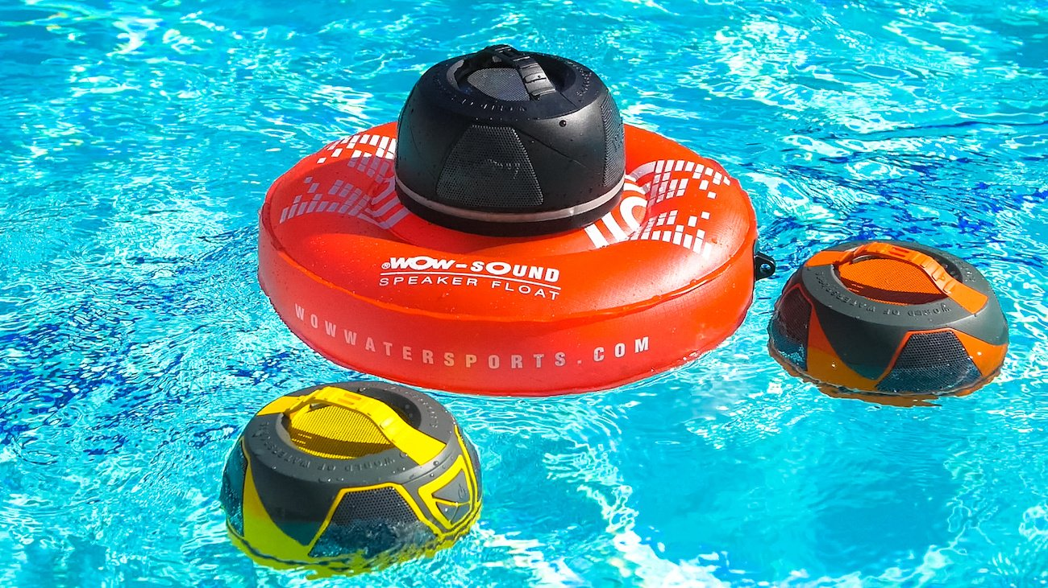
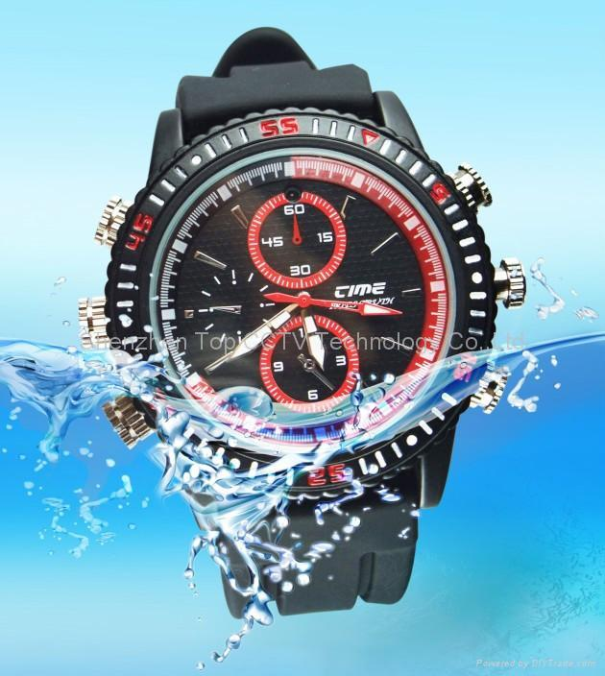
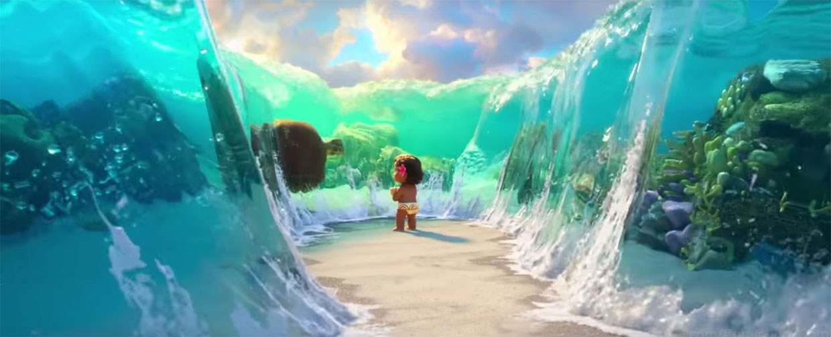
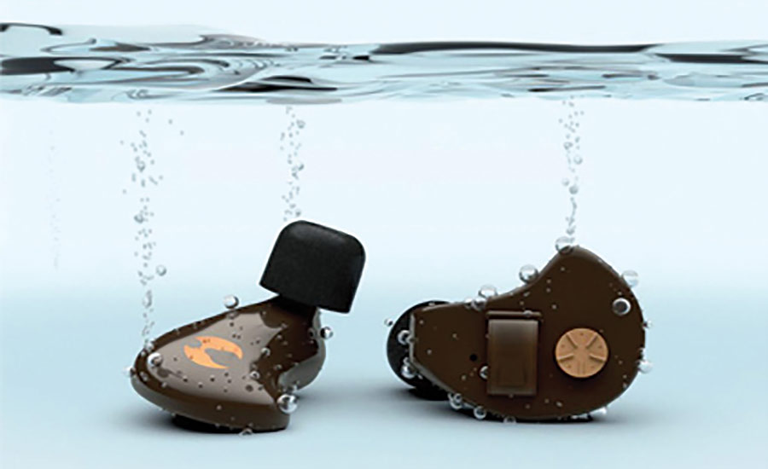
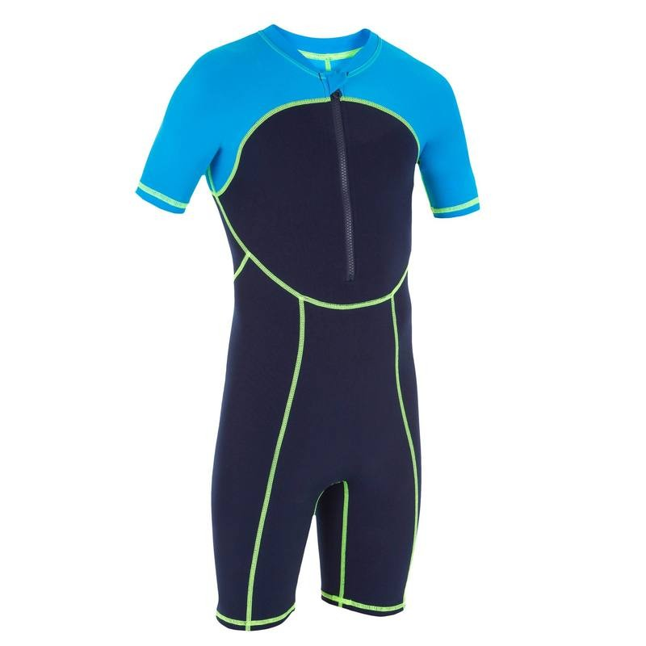
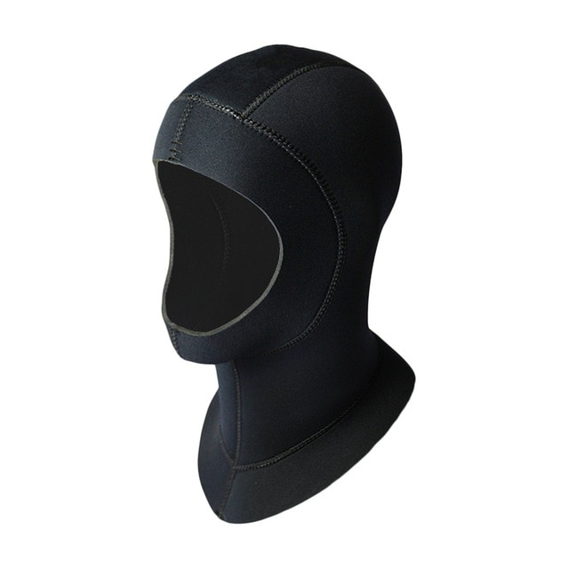
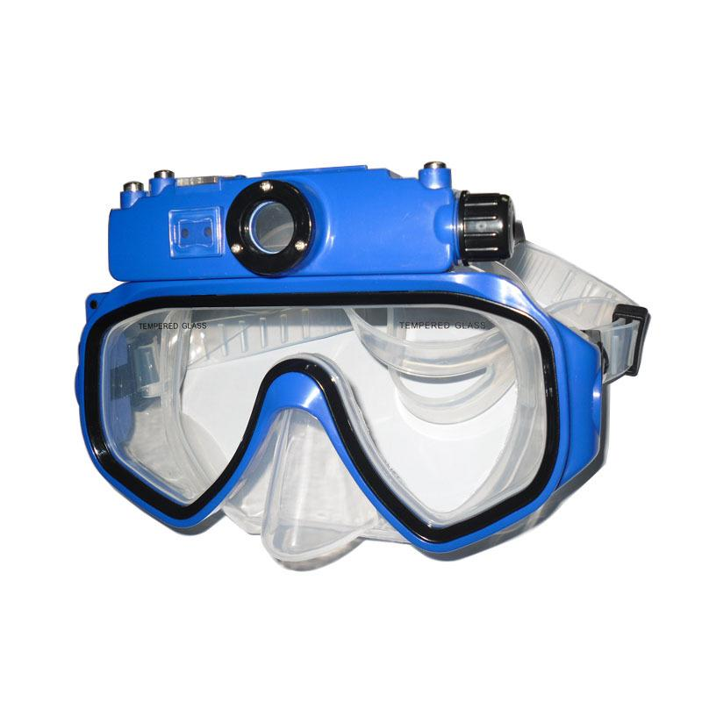
hb
CONCEPTS

Slide 20
Pugh matrix
Criteria | Sound |  | Vibration |  | Flashlight |  | Light & Vibration
 | Speaker | earplugs | Watch | hat | Watch | Glasses | Watch
Reliability | - | - | + | + | S | + | +
Initial cost | - | - | + | - | + | S | +
Efficient | - | + | S | + | S | + | +
Endurance | + | - | S | - | S | S | -
Safety | - | - | + | - | + | + | +
Mobility | - | + | + | - | + | + | +
Complexity | - | - | S | - | + | - | S
∑(+) | 1 | 2 | 4 | 2 | 4 | 4 | 5
∑(-) | 6 | 5 | 0 | 5 | 0 | 1 | 1
∑(S) | 0 | 0 | 3 | 0 | 3 | 2 | 1

Slide 21
Criteria | Reliability | initial Cost | Efficient | Endurance | Safety | Mobility | Complexity
Reliability | 1.00 | 0.20 | 0.33 | 1.00 | 3.00 | 0.20 | 0.11
initial Cost | 5.00 | 1.00 | 1.00 | 0.20 | 7.00 | 5.00 | 0.14
Efficient | 3.00 | 1.00 | 1.00 | 0.33 | 5.00 | 0.20 | 1.00
Endurance | 1.00 | 5.00 | 3.00 | 1.00 | 7.00 | 0.33 | 0.20
Safety | 0.33 | 0.14 | 0.20 | 0.14 | 1.00 | 0.33 | 0.14
Mobility | 5.00 | 0.20 | 5.00 | 3.00 | 3.00 | 1.00 | 0.33
Complexity | 9.00 | 7.00 | 1.00 | 5.00 | 7.00 | 3.00 | 1.00

Slide 22
Criteria | Reliability | initial Cost | Efficient | Endurance | Safety | Mobility | Complexity | sum | average
Reliability | 0.0410959 | 0.0137525 | 0.0289017 | 0.0936664 | 0.0909091 | 0.0198675 | 0.03791983 | 0.326113 | 0.081528
Cost | 0.2054795 | 0.0687623 | 0.0867052 | 0.0187333 | 0.2121212 | 0.4966887 | 0.04875406 | 1.137244 | 0.284311
Efficient | 0.1232877 | 0.0687623 | 0.0867052 | 0.0312221 | 0.1515152 | 0.0198675 | 0.34127844 | 0.822638 | 0.20566
Endurance | 0.0410959 | 0.3438114 | 0.2601156 | 0.0936664 | 0.2121212 | 0.0331126 | 0.06825569 | 1.052179 | 0.263045
Safety | 0.0136986 | 0.0098232 | 0.017341 | 0.0133809 | 0.030303 | 0.0331126 | 0.04875406 | 0.166413 | 0.041603
Mobility | 0.2054795 | 0.0137525 | 0.433526 | 0.2809991 | 0.0909091 | 0.0993377 | 0.11375948 | 1.237763 | 0.309441
Complexity | 0.369863 | 0.481336 | 0.0867052 | 0.4683318 | 0.2121212 | 0.2980132 | 0.34127844 | 2.257649 | 0.564412

Slide 23
Reliability |  | Sound |  | vibration |  |  | Flashlight |  | Light&Vibration
 |  | speaker | earplugs | watch | suit | hat | Watch | Glasses | Watch | evaporate the water away
Sound | speaker | 1.00 | 5.00 | 7.00 | 9.00 | 7.00 | 5.00 | 9.00 | 9.00 | 9.00
 | earplugs | 0.20 | 1.00 | 0.33 | 5.00 | 5.00 | 0.14 | 5.00 | 7.00 | 9.00
vibration | watch | 0.14 | 3.00 | 1.00 | 5.00 | 3.00 | 0.20 | 7.00 | 5.00 | 9.00
 | suit | 0.11 | 0.20 | 0.20 | 1.00 | 0.33 | 0.14 | 1.00 | 0.33 | 9.00
 | hat | 0.14 | 0.20 | 0.33 | 3.00 | 1.00 | 0.20 | 5.00 | 1.00 | 9.00
Flashlight | Watch | 0.20 | 5.00 | 5.00 | 7.00 | 5.00 | 1.00 | 7.00 | 7.00 | 9.00
 | Glasses | 0.11 | 0.20 | 0.14 | 1.00 | 0.20 | 0.14 | 1.00 | 0.33 | 9.00
Light&Vibration | Watch | 0.11 | 0.14 | 0.20 | 3.00 | 1.00 | 0.14 | 3.00 | 1.00 | 9.00
 | viperate the water away | 0.11 | 0.11 | 0.11 | 0.11 | 0.11 | 0.11 | 0.11 | 0.11 | 1.00

Slide 24
Reliability |  | Sound |  | vibration |  |  | Flashlight |  | Light&Vibration
 |  | speaker | earplugs | watch | suit | hat | Watch | Glasses | Watch | evaporate the water away | sum | Average
Sound | speaker | 0.469449 | 0.33661 | 0.488805 | 0.263844 | 0.309127 | 0.705961 | 0.236152 | 0.292419 | 0.123287671 | 3.225654 | 0.358406
 | earplugs | 0.09389 | 0.067322 | 0.023276 | 0.14658 | 0.220805 | 0.02017 | 0.131195 | 0.227437 | 0.123287671 | 1.053963 | 0.117107
vibration | watch | 0.067064 | 0.201966 | 0.069829 | 0.14658 | 0.132483 | 0.028238 | 0.183673 | 0.162455 | 0.123287671 | 1.115577 | 0.123953
 | suit | 0.052161 | 0.013464 | 0.013966 | 0.029316 | 0.01472 | 0.02017 | 0.026239 | 0.01083 | 0.123287671 | 0.304155 | 0.033795
 | hat | 0.067064 | 0.013464 | 0.023276 | 0.087948 | 0.044161 | 0.028238 | 0.131195 | 0.032491 | 0.123287671 | 0.551126 | 0.061236
Flashlight | Watch | 0.09389 | 0.33661 | 0.349147 | 0.205212 | 0.220805 | 0.141192 | 0.183673 | 0.227437 | 0.123287671 | 1.881253 | 0.209028
 | Glasses | 0.052161 | 0.013464 | 0.009976 | 0.029316 | 0.008832 | 0.02017 | 0.026239 | 0.01083 | 0.123287671 | 0.294277 | 0.032697
Light&Vibration | Watch | 0.052161 | 0.009617 | 0.013966 | 0.087948 | 0.044161 | 0.02017 | 0.078717 | 0.032491 | 0.123287671 | 0.462519 | 0.051391
 | viperate the water away | 0.052161 | 0.00748 | 0.007759 | 0.003257 | 0.004907 | 0.015688 | 0.002915 | 0.00361 | 0.01369863 | 0.111476 | 0.012386

Slide 25
Concept Solutions |  | Weighted Evaluation
Light&Vibration | Watch | 0.059183397
Flashlight | Glasses | 0.065287761
vibration | watch | 0.07647441
Flashlight | Watch | 0.099318791
vibration | hat | 0.21042757
vibration | suit | 0.212046524
Sound | earplugs | 0.238554177
Sound | speaker | 0.308374047
viperate the water away |  | 0.480333325

Slide 26
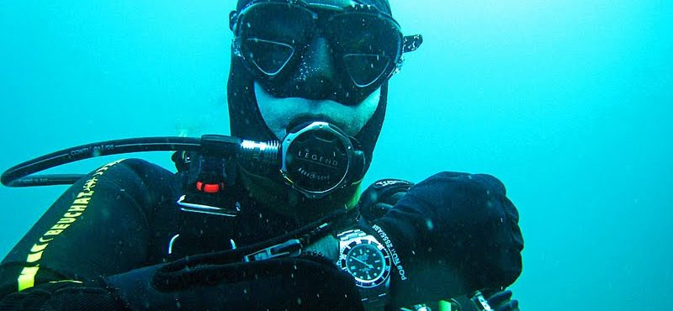

Slide 27
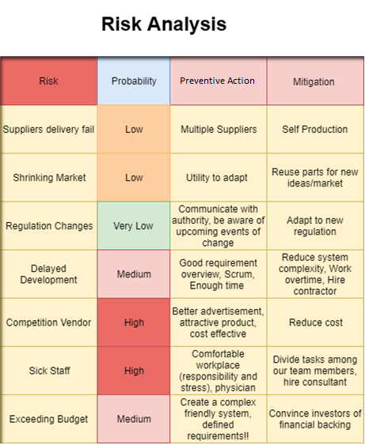
RISK

Slide 28
System requirement
ID | System Requirement | Requirement origin | Verification | SH Code | Type | Priority
SYSR1 | The system must be able to withstand a certain pressure range. | SHR3, SHR12 | Use pressure tank to verify the system’s threshold. Development | US, MT | NFR | URG
SYSR2 | The system must be able to be water resistant | SHR5, SHR12 | Inspection of system under water level. | DS, MT | NFR | BLC
SYSR3 | The system has to be rust free. | SHR5, SHR9, SHR 11 | Salt spray test | DS, EVM, MF, MT | NFR | NOR
SYSR4 | The system must emphasize warning regarding to low oxygen level | SHR2, | inspection | US, AT | FR | BLC

Slide 29
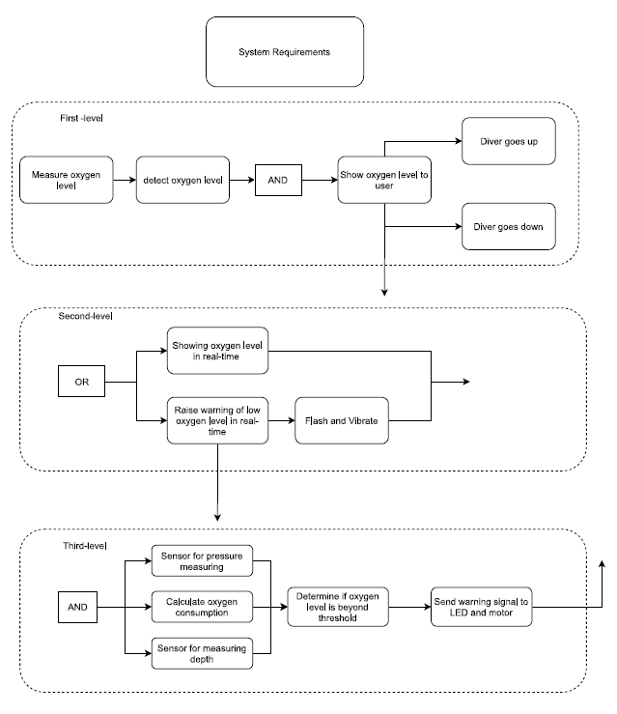
Functional Analysis Block Diagram

Slide 30
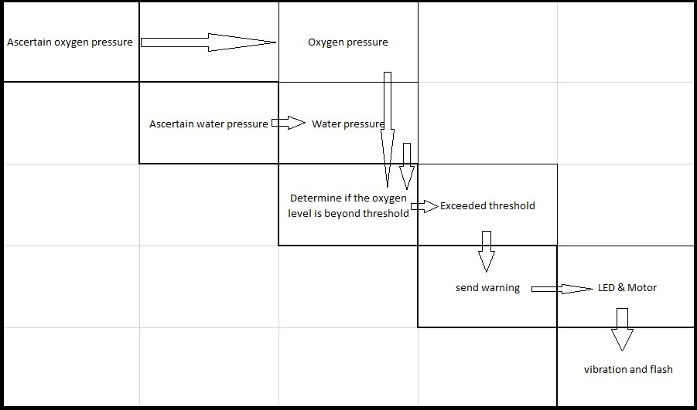

Slide 31
Verification and validation
Analysis
Critical Design Review
Bottoms up

Slide 32
WATCH Your scuba diving
by: Security Application Via Engineering AS
Honorable mentions:
Chrisander Bronstad
Jan Ali
Joe Liu
Zakiya Yusefi

